Slide 1

Vel Tech Rangarajan Dr. Sagunthala R&D Institute of Science and Technology
School of Computing
Department of Computer Science and Engineering
10211CS224 / FULL STACK APPLICATION DEVELOPMENT (JAVA)
PROJECT REVIEW : MILESTONE PROJECT – 1
Date: 30-03-2026
REAL-TIME EVENT SYNCHRONIZATION ENGINE
Presented By:
B ROSHMASRI – VTU25061 – 23UECS0675
Courses Handling Faculty:
Dr. ANGELINE LYDIA

Slide 2
INTRODUCTION
1
A Real-Time Event Synchronization Engine is a system designed to instantly capture, process, and distribute events across multiple applications and services.
It ensures seamless communication between distributed systems without delays or data conflicts.
The engine continuously monitors event streams and synchronizes updates in real time.
It improves system performance by reducing latency and eliminating manual data refresh.
The architecture supports scalable microservices and cloud-based environments.
It guarantees data consistency, reliability, and fault tolerance during high traffic loads.
The engine enables live dashboards, notifications, and automated workflows.
It enhances user experience by providing accurate and up-to-date information instantly.
This project aims to build a secure, efficient, and scalable synchronization platform for modern web applications.
2
3
4
5
6
7
8
9

Slide 3
PROBLEM STATEMENT
1
• Modern applications experience delays in updating data across multiple systems. • Lack of real-time synchronization causes inconsistent and outdated information. • Distributed systems face data conflicts during simultaneous updates. • High latency reduces the performance of live dashboards and notifications. • Manual data refresh methods decrease system efficiency. • Existing solutions struggle to scale under heavy user traffic. • System failures can lead to event loss and reliability issues. • Insecure event transmission increases security vulnerabilities. • There is a need for a secure, scalable, and reliable real-time event synchronization engine.
2
3
4
5
6
7
8
9

Slide 4
OBJECTIVE(S)
1
2
• To design and develop a real-time event synchronization engine for distributed systems. • To ensure instant data updates across multiple applications without delay. • To maintain data consistency and integrity during concurrent operations. • To reduce system latency and improve overall performance. • To build a scalable architecture that supports high traffic loads. • To implement fault-tolerant mechanisms to prevent event loss. • To enhance security through encrypted and validated event transmission. • To enable live dashboards, notifications, and automated workflows. • To improve user experience by delivering accurate and up-to-date information in real time.
3
4
5
6
7
8
9

Slide 5
PROPOSED SYSTEM
1
• The proposed system introduces a Real-Time Event Synchronization Engine that captures and processes events instantly. • It uses an event-driven architecture to enable smooth communication between distributed applications. • The system ensures real-time data updates across multiple platforms without manual intervention. • It implements message queues or streaming mechanisms to handle high volumes of events efficiently. • The proposed model includes fault-tolerant features to prevent data loss during system failures. • It supports scalability to manage increasing user traffic and growing system demands. • Security mechanisms such as encryption and authentication are integrated to protect event data. • The system provides live dashboards, alerts, and automated workflows for better monitoring. • Overall, the proposed system delivers a reliable, secure, and high-performance synchronization solution.
2
3
4
5
6
7
8
9

Slide 6
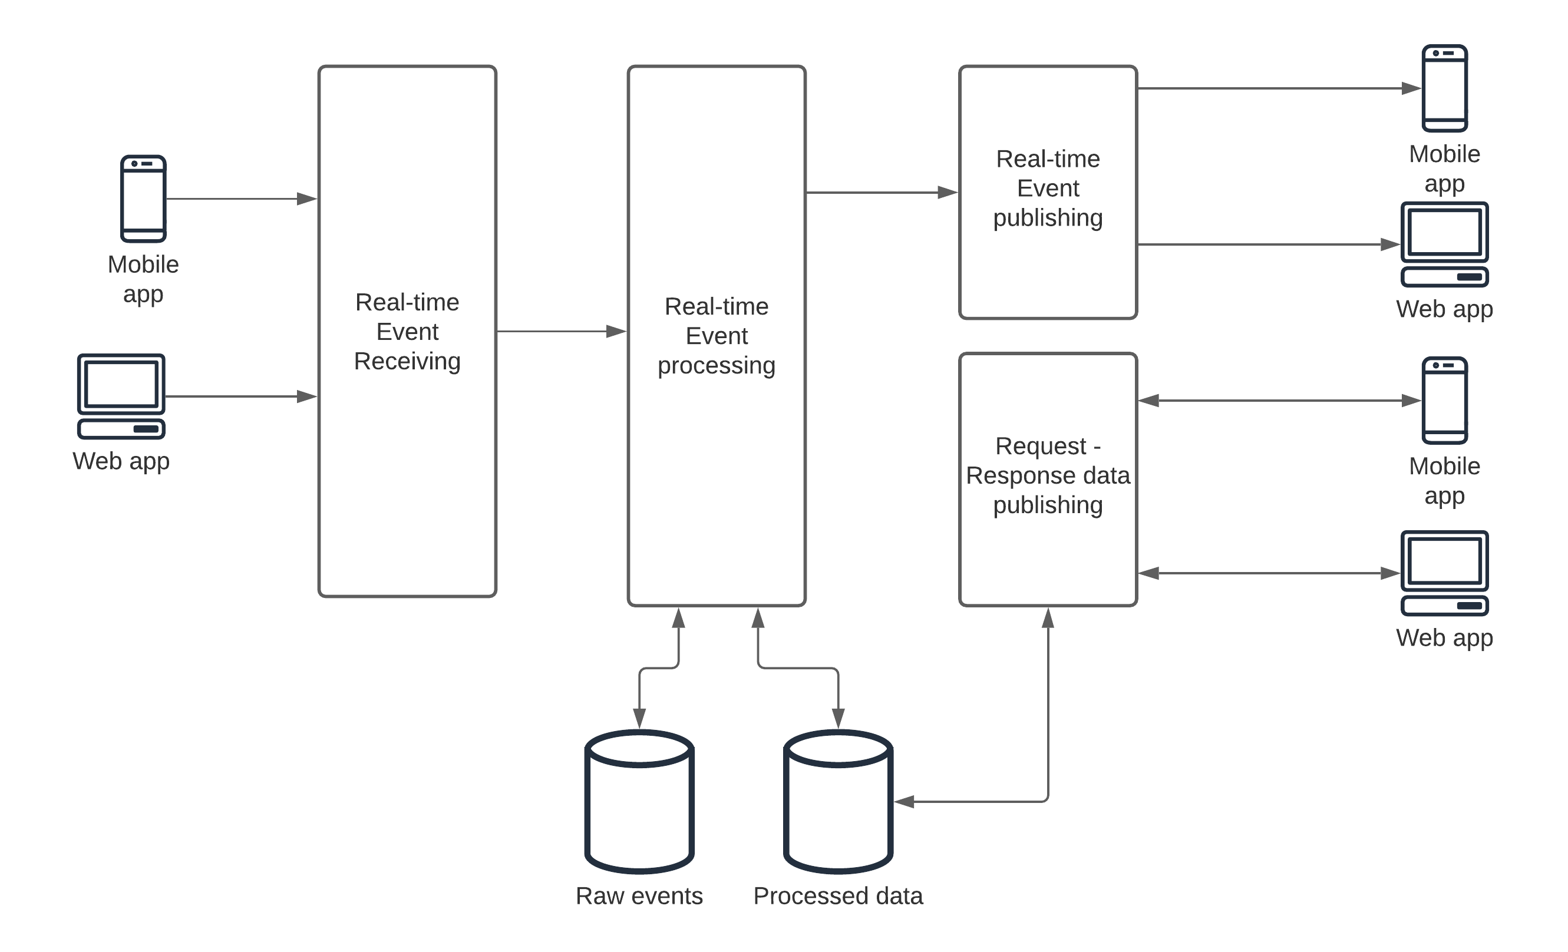
PROPOSED SYSTEM ARCHITECTURE
1
2
3
4
5
6
7
8
9

Slide 7
• Input:
• Collects real-time data from web apps, mobile apps, APIs, and external systems. • Accepts various event types such as user actions, transactions, and system updates. • Validates incoming data to ensure accuracy and proper format before processing.
• Processing:
• Applies business rules and event-handling logic to incoming data. • Filters, transforms, and sequences events to avoid conflicts. • Ensures low-latency synchronization across distributed systems.
• Database:
• Stores synchronized events in a secure and structured format. • Maintains data consistency and integrity across multiple services. • Supports fast retrieval and backup mechanisms for reliability.
• Output:
• Sends real-time updates to dashboards and connected applications. • Triggers notifications, alerts, or automated workflows. • Provides accurate, up-to-date information to end users instantly.

Slide 8
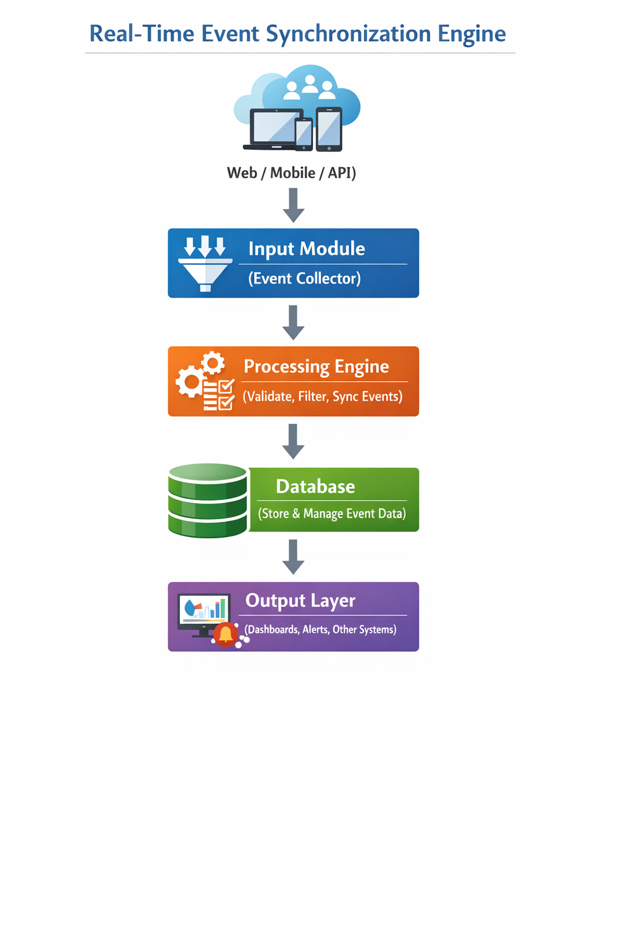
WORKFLOW
1
2
3
4
5
6
7
8
• The system collects real-time data from web, mobile, and API sources through the input module. • The processing engine validates and synchronizes events before securely storing them in the database. • Updated information is instantly delivered to dashboards, alerts, and connected systems through the output layer.
9

Slide 9
TECHNOLOGIES USED
1
Frontend:
• HTML, CSS, and JavaScript
• React
• Socket.io-client
• Backend:
• Node.js / Express.io / Socket.io • JSON Web Token
Database:
• MOngoDB • Mongoose
Tools:
• npm / Nodemon / Dotenv • Git and PostCSS
Hardware/Software Requirements:
• Software: Node.js,npm,MongoDB,Modern Web Browser • Hardware: PC,4GB RAM,internet connectivity(for real time Socket)
2
3
4
5
6
7
8
9

Slide 10
MODULE DESCRIPTION
1
2
Module 1: Event Collection & Input Management
Captures real-time events from web, mobile, and API sources and validates incoming data before processing.
Module 2: Event Processing & Synchronization
Applies business logic, filters events, resolves conflicts, and synchronizes data across distributed systems.
Module 3: Database & Storage Management
Stores processed events securely, maintains data consistency, and supports fast retrieval and backup mechanisms.
Module 4: Monitoring & Notification System
Provides live dashboards, triggers alerts, and delivers real-time updates to connected applications and users.
3
4
5
6
7
8
9

Slide 11
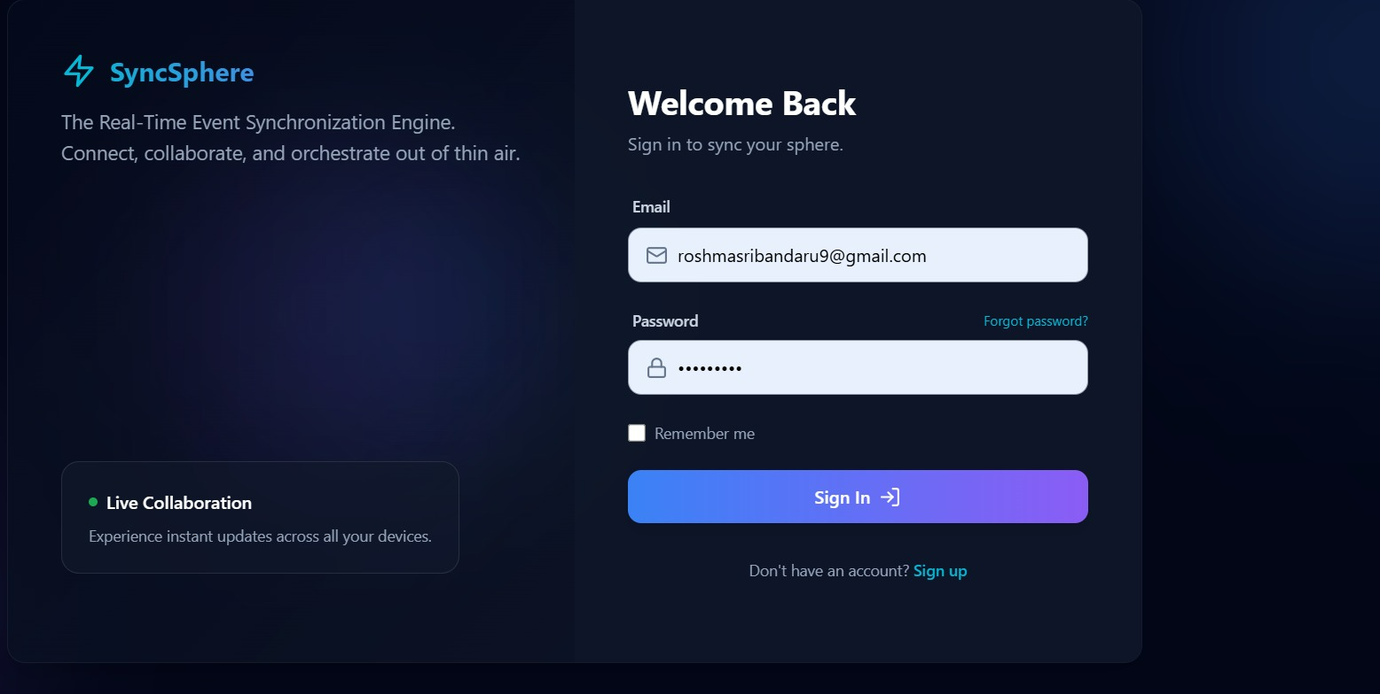
IMPLEMENTATION SCREENSHOTS
1
2
3
4
5
6
7
8
9

Slide 12
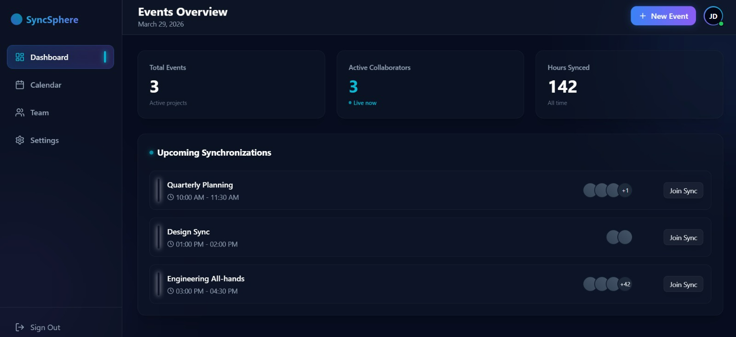
IMPLEMENTATION SCREENSHOTS
1
2
3
4
5
6
7
8(A)
9

Slide 13
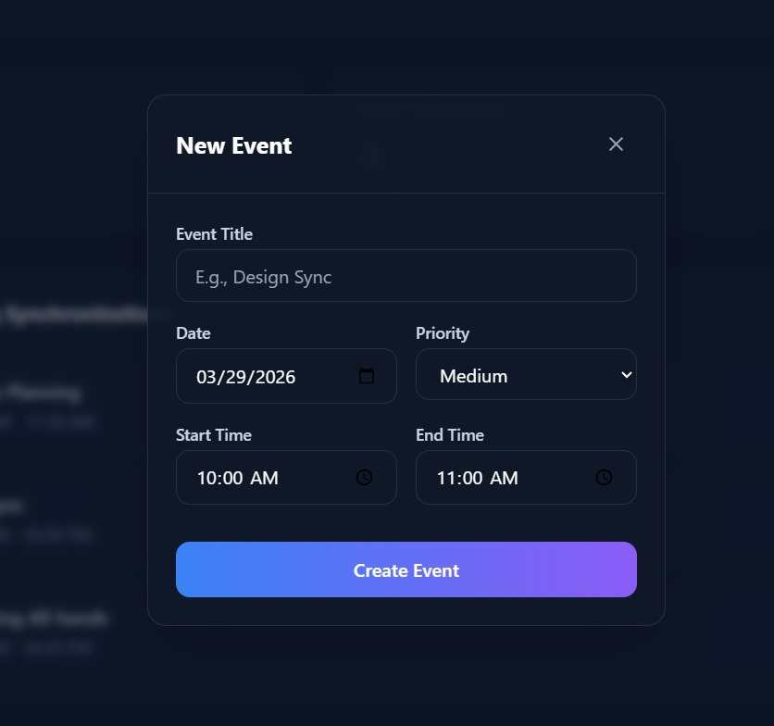
IMPLEMENTATION SCREENSHOTS
1
2
3
4
5
6
7
8(B)
T
9

Slide 14
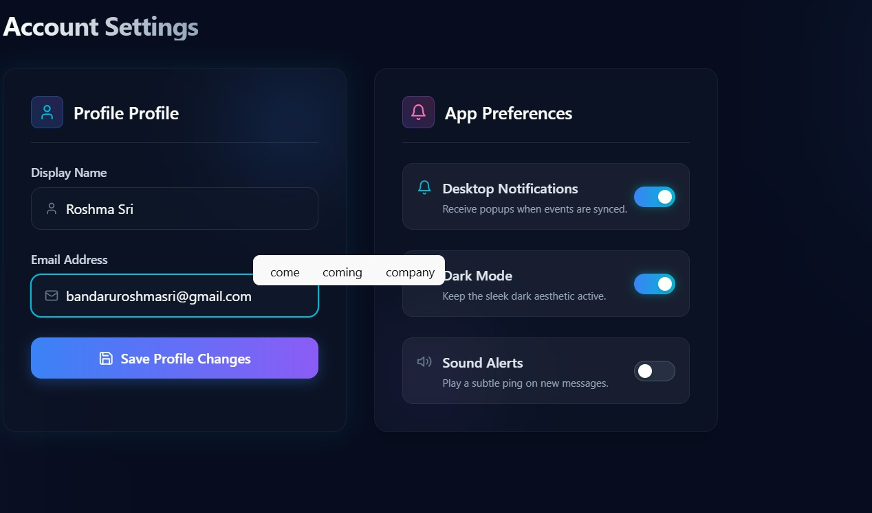
IMPLEMENTATION SCREENSHOTS
1
2
3
4
5
6
7
8(C)
9

Slide 15
ADVANTAGES & LIMITATIONS
1
Advantages:
• Provides real-time data synchronization with minimal latency. • Ensures data consistency across multiple applications and platforms. • Improves system efficiency by eliminating manual data updates. • Supports scalability to handle increasing users and event traffic. • Enhances user experience through live dashboards and instant notifications.
Limitations:
• Requires stable internet connectivity for continuous synchronization. • High implementation complexity compared to traditional systems. • Initial setup and infrastructure cost may be higher. • Performance may be affected under extremely heavy traffic without proper scaling. • Security risks can arise if event data is not properly encrypted and monitored.
2
3
4
5
6
7
8
9

Slide 16
Thank you

